Slide 1

2020
SMART MEDICINE DRAWER
By: TECHIE WARLOCKS

Slide 2
1
5
Brief about our project.
Shows connections of all components.
INTRODUCTION
CIRCUIT DESIGN
2
What issue we are resolving with the project/drawer.
6
Working of the project step by step.
PROBLEM & SOLUTION
MECHANISM
3
7
Sketchs of the projct.
Detailed explanation of the code used.
DRAWINGS
CODE IMPLEMENTATION
4
All the modules are shown which are used.
8
Final live working of the project
MODULES USED
EXECUTION

Slide 3
Introduction
● Smart Medicine Drawer is an advanced automated drawer specially designed for patients to help them maintain medication.
● It's basic role is that it produces sound at the time of medicine and open automatically at that time, reminding patient that it's time to take medicine.
Smart medicine drawer
Smart medicine drawer
It will reduce the in person support for patients.
it is an advancement of our daily medicine's routine
Smart medicine drawer
Smart medicine drawer
Smart medicine drawer
Lesser number of care takers will be needed.
It will help maintaining medication with proper timings

Slide 4

To resolve this problem of medical adherence we have come up with a solution that is our device Smart Medicine Drawer.
Need device which tells when to take medicine and which medicine.
PROBLEM
SOLUTION
Need device for the proper medication of patient
This drawer will remind the patients to take their medicines at the proper time.
Patient cannot remember all the medicines.
The patient will not need a person everytime for taking medicines.

Slide 5
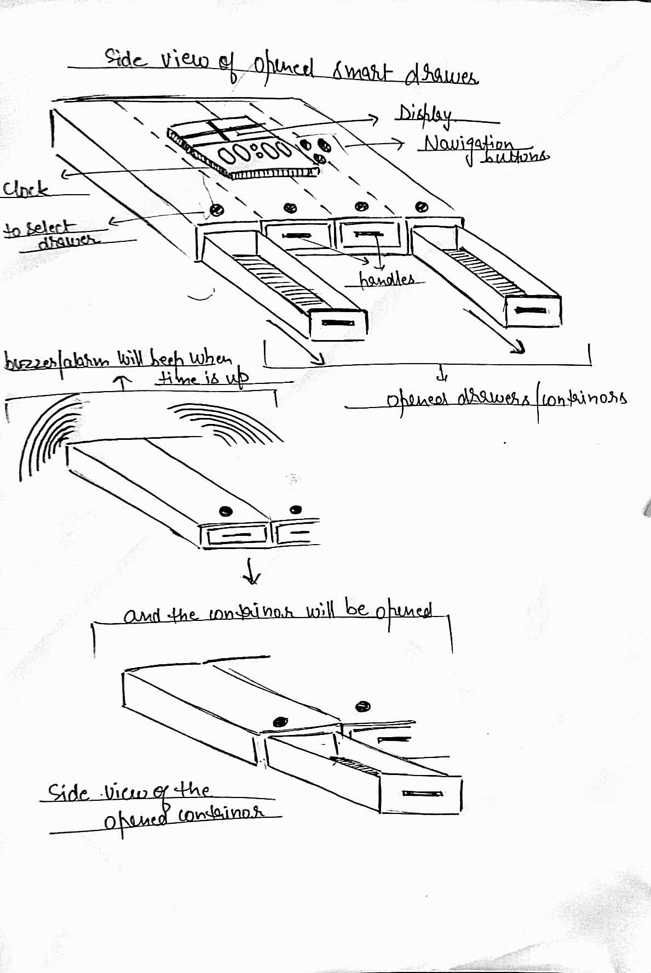
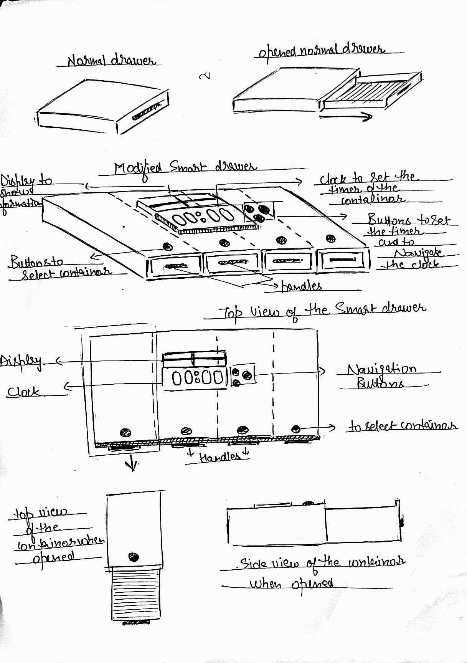

HANDMADE DRAWINGS
WHEN IT OPENS
WHEN DRAWER IS CLOSED

Slide 6

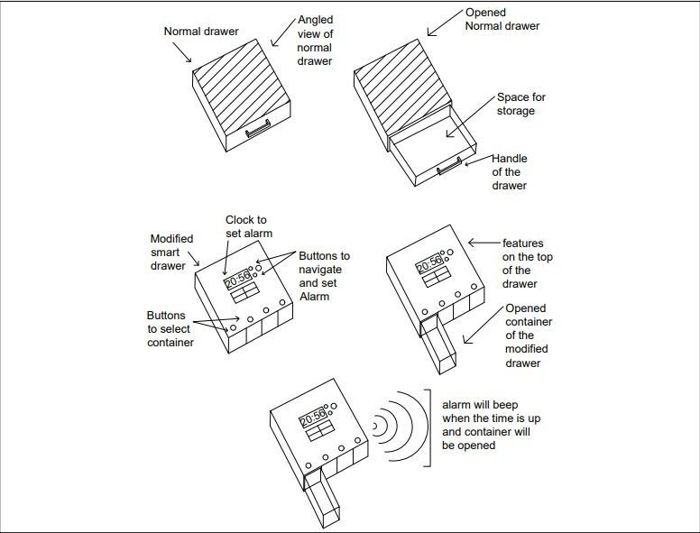
AUTOCAD DRAWING

Slide 7
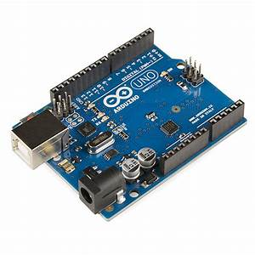
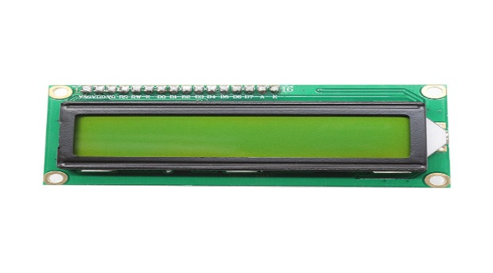
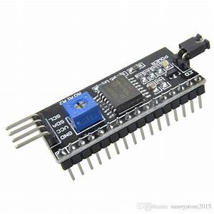
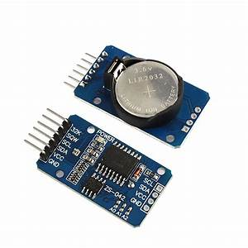
MODULES USED
ARDUINO UNO
LCD DISPLAY
I2C MODULE
REAL TIME CLOCK
The Arduino Uno is an open-source microcontroller board based on the Microchip ATmega328P microcontroller. We have used it for building up our circuit and control all the inputs and outputs.
This LCD is an electronic display module that uses liquid crystal to produce a visible image . In our circuit we are using it to display time.
The Time Clock Module ( or DS3231 ) is a module that measures the time. In our circuit it is helping us to maintain accurate timekeeping.
This module is used to control the LCD display forming the I2C interface.

Slide 8
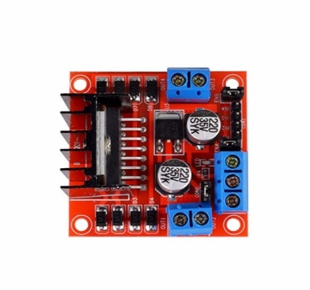
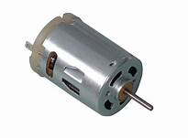
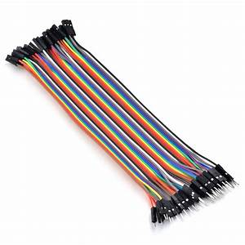
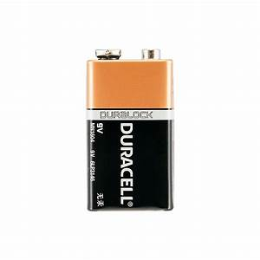
MODULES USED
L298N MOTOR DRIVER
DC MOTOR
JUMP WIRES
9-V BATTERY
The L298N is a dual-channel H-Bridge motor driver capable of driving two DC motors and one stepper motor. means it can individually drive up to two DC motor for any applications.
A DC motor is any of a class of rotary electrical motors that converts direct current electrical energy into mechanical energy. We are using it for opening and closing of drawer.
A jump wire is an electrical wire used to interconnect the components of the circuit.
We’ll be using battery in case we do not have any other power source.

Slide 9
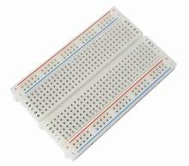
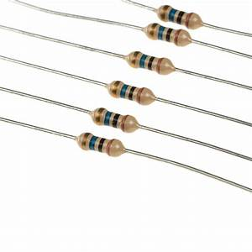
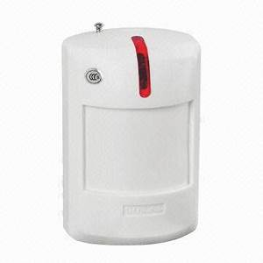
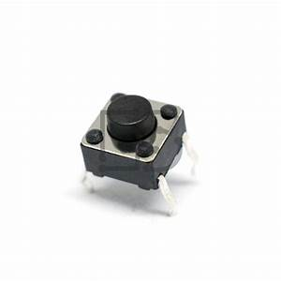
MODULES USED
PUSH BUTTON
RESISTORS
PASSIVE ALARM
BREADBOARD
Push buttons are used in our circuit for setting up the time and entering it.
A resistor is a passive two-terminal electrical component that implements electrical resistance as a circuit element.
Passive alarm are automatically activated and emit warning sounds at the time of medication.
A breadboard is a construction base for prototyping of electronics. It helps us to build up circuit without soldering.

Slide 10
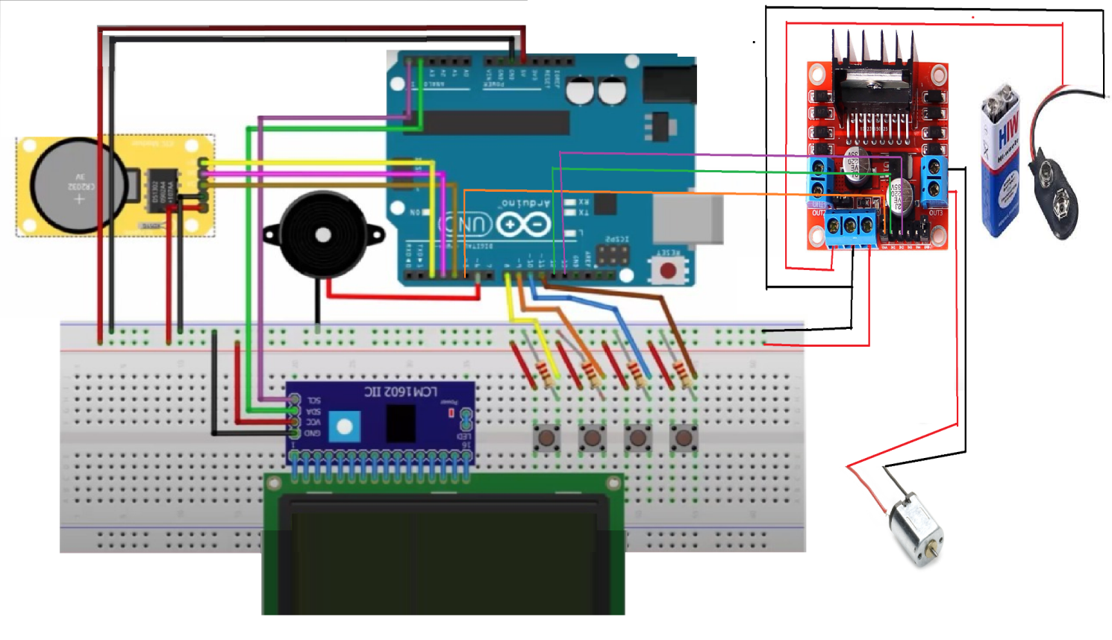
CIRCUIT DAIGRAM
Arduino
Core Of Circuit

Slide 11






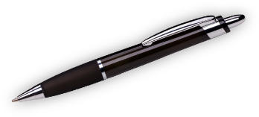
CIRCUIT EXPLAINED
The Breadboard is connected to arduino's ground and power(5V) pins.
Here resistors are used to ensure that the pins get a stable voltage.The piezzo buzzer is connected to analog output simulation pin , so that it will produce sound at the alarm time.
STEP
STEP
01
04
Then the real time clock is connected to breadboard and arduino, it will be helping us to maintain accurate time keeping.
STEP
STEP
02
05
Further we have used L298N DC Motor Driver Module in our circuit for opening and closing of the drawer.
we have plugged in the I2C in the ports of the LCD and connected the I2C to analog pins of arduino. The pushbuttons are then connected to set up the alarm time
STEP
STEP
03
06
L298N is connected to the DC motor, Arduino and bread board.

Slide 12
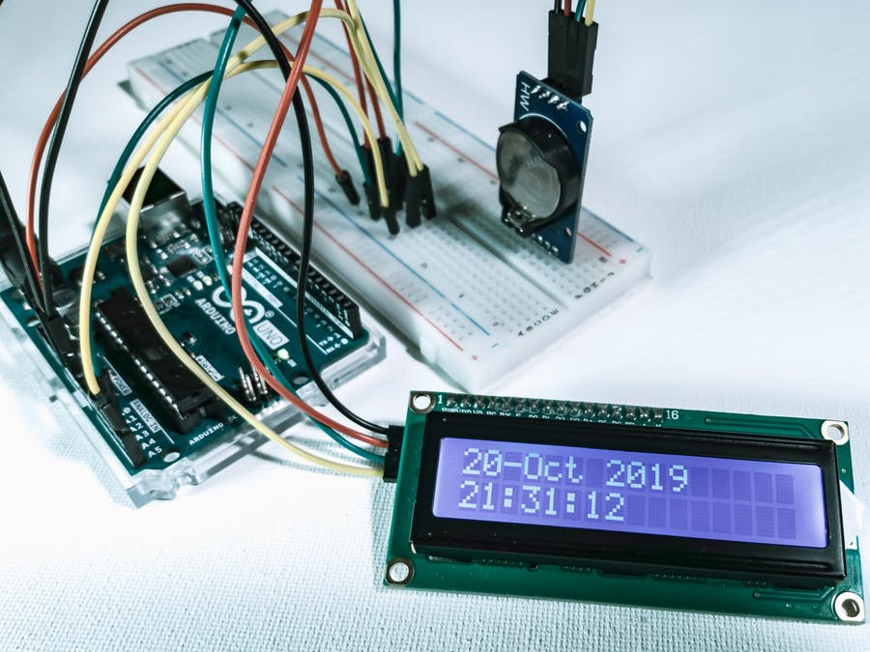
MECHANISM :
PHASE 1
WE NEED TO SET UP THE TIME FOR ALARM WITH THE HELP OF PUSH BUTTONS.
AFTER SETTING ALARM WE WILL SET THE FREQUENCY OF THE ALARM.
STEP
01

Slide 13
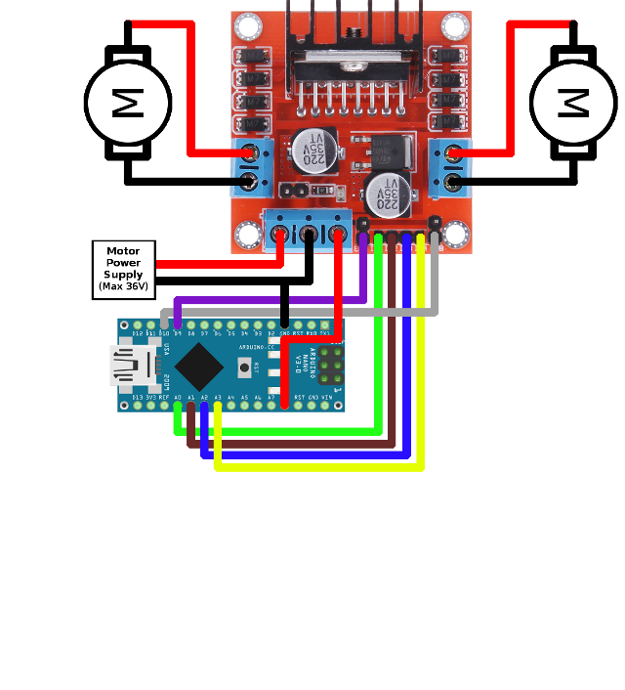
MECHANISM :
PHASE 2
THE REAL TIME CLOCK WILL START SHOWING ACTUAL TIME AFTER SETTING ALARM.
WHENEVER THE REAL TIME WILL MATCH WITH ALARM TIME, PIEZZO BUZZER WILL START BUZZING AND DRAWER WILL COME OUT.
STEP
02

Slide 14
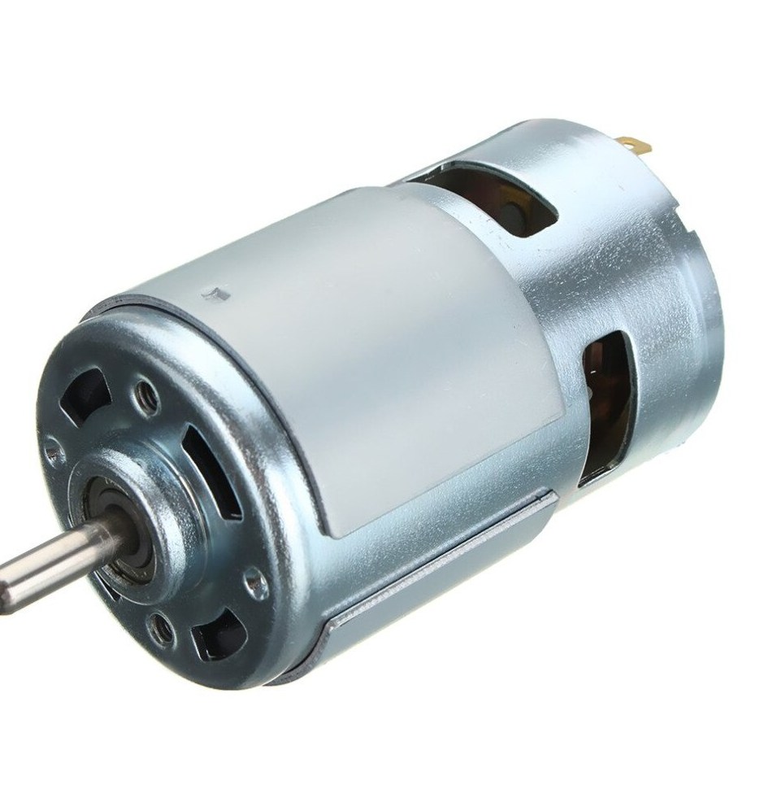
MECHANISM :
PHASE 3
PATIENT CAN TAKE HIS OR HER MEDICINE FROM DRAWERONCE IT IS OPEN.
AFTER SOMETIME THE MOTOR WILL START ROTATING IN OPPOSITE DIRECTION AND DRAWER WILL BE CLOSED.
STEP
03

Slide 15



CODE IMPLEMENTATION
Here is the overall analysis of the whole code which will operate the smart medicine drawer and we have divided this code into “THREE” sections.
SECTION 01
SECTION 02
SECTION 03
DEFINE
SET UP
LOOP
In this part we have mentioned the packages/libraries required and have declared the required variables
In this part we have declared the state for each of the component of our circuit.
In this part we will be setting up the time for the alarm and the LCD display and at last finally we have the condition loop for opening of drawer

Slide 16
#include <Wire.h>
#include <LiquidCrystal_I2C.h>
#include <DS1302.h>
LiquidCrystal_I2C lcd(0x3F, 16, 2);
int Hour;
int Min;
int pset = 8; // pushbutton for setting alarm
Int phour = 9, pmin = 10 ,pexit = 11 , buzzer = 6;
int buttonforset = 0; // pushbutton state
Int buttonforhour = 0,buttonformin = 0,buttonforexit = 0;
int activate=0;
Time t;
// Motor connections
int enA = 5;
int in1 = 12;
int in2 = 13;
DEFINE

Slide 17
pinMode(pset, INPUT);
pinMode(phour, INPUT);
pinMode(pmin, INPUT);
pinMode(pexit, INPUT);
// Set the clock to run-mode
rtc.halt(false);
rtc.writeProtect(false);
// Set all the motor control pins to outputs
pinMode(enA, OUTPUT);
pinMode(in1, OUTPUT);
pinMode(in2, OUTPUT);
// Turn off motors - Initial state
digitalWrite(in1, LOW);
digitalWrite(in2, LOW);
SET UP

Slide 18
if (activate == 0) {
lcd.print(rtc.getDateStr());
t = rtc.getTime();
Hour = t.hour;
Min = t.min;
If(buttonforset == HIGH){
activate =1;
if (buttonforhour == HIGH)
if (h>23){
h=0;}
if (buttonformin == HIGH){
if (m>59){
m=0; }
if (buttonforexit == HIGH){
activate = 0; }}
if (Hour== h && Min== m) {
tone(6,400,300);
digitalWrite(in1, HIGH);
digitalWrite(in2, LOW);
delay(1800000);
digitalWrite(in1, LOW);
digitalWrite(in2, HIGH);
delay(2000);
digitalWrite(in1, LOW);
digitalWrite(in2, LOW);}
Real Time State
LOOP
Alarm State

Slide 19
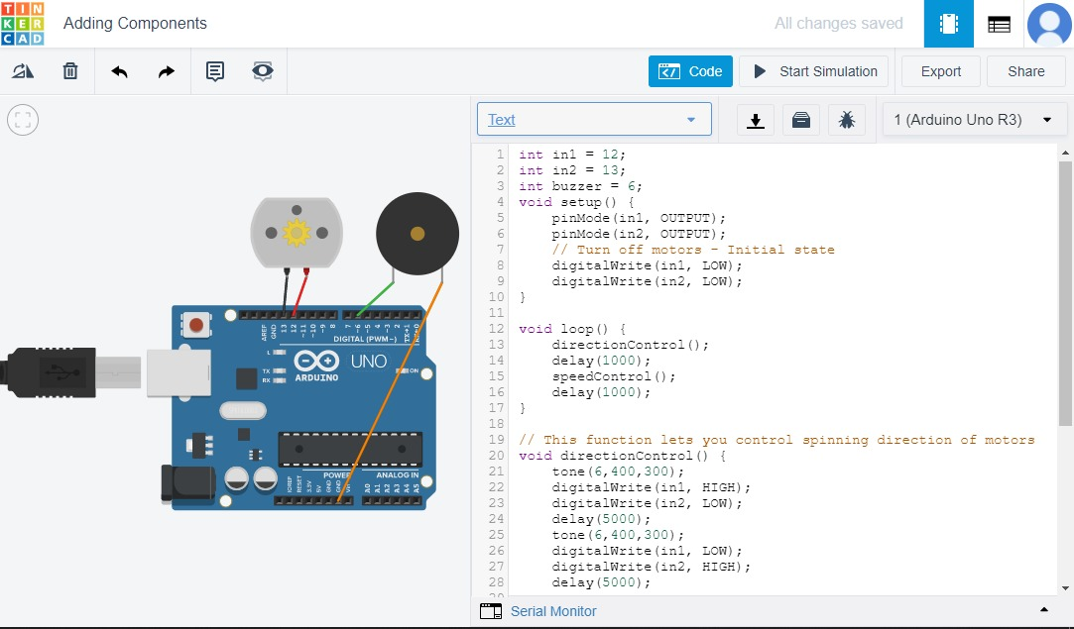
EXECUTION
Screenshot of arduino UNO connected with Buzzer and DC motor.

Slide 20
THANKS
FROM: TECHIE WARLOCKS

